Slide 1


Flickr chanzephotoart
Responsible Media
Unpacking the challenges & opportunities
of modern advertising and media.
Jerry Daykin, Senior Media Director GSK Consumer Healthcare
(Conscious Advertising Network // Global Alliance Responsible Media)
Notes:
Flickr chanzephotoart, Creative Commons license

Slide 2


Slide 3
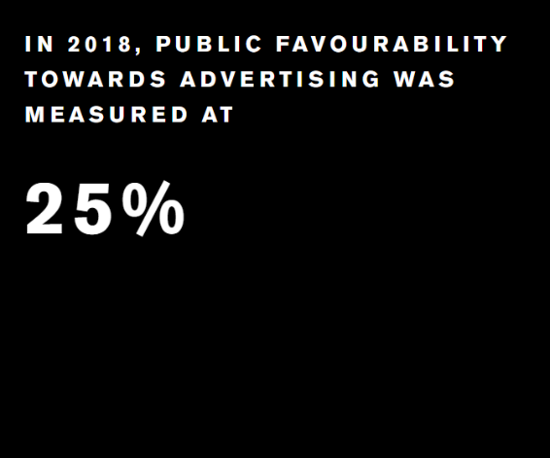

Facing Into Media’s Challenges
Consumers Have Lost Trust
‘Arresting The Decline Of Public Trust In UK Advertising’
Data breaches and privacy concerns
Advertisers Have Lost Trust
ISBA/PWC Programmatic Audit
Front page brand safety scandals
Various supply chain/agency transparency concerns
Advertisers Have Lost Effectiveness
Binet & Field, the decline of advertising effectiveness
IAB ‘Don’t Be A Clickhead’
We’re Funding the Wrong Content
Crisis in funding journalism and quality content
Rise in click bait, fake news and hate speech
Closure of publications, diverse voices
Widespread job threat across agency sector

Slide 4

Do You Want to Build a Better Internet?

Slide 5











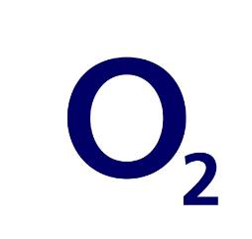













The Conscious Advertising Network is a voluntary coalition of over 70 organisations set up to ensure that industry ethics catches up with the technology of modern advertising.
consciousadnetwork.com // @consciousadnet
Notes:
VOLUNTEER. NON PROFIT.

Slide 6
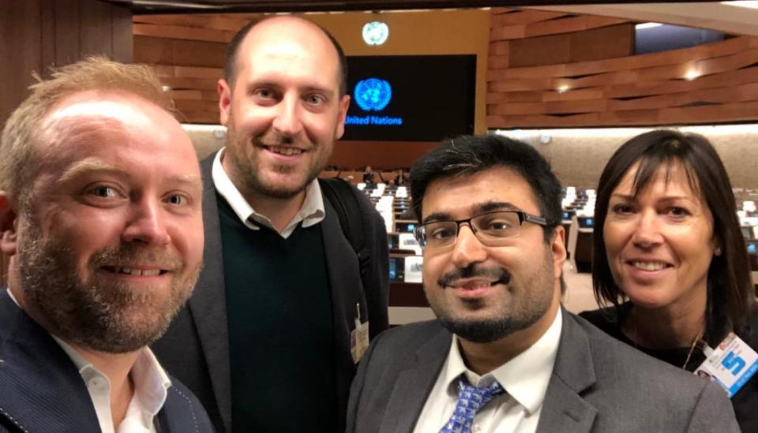
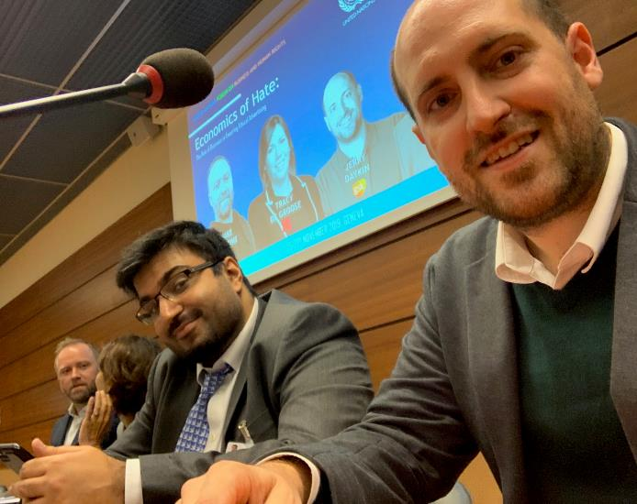
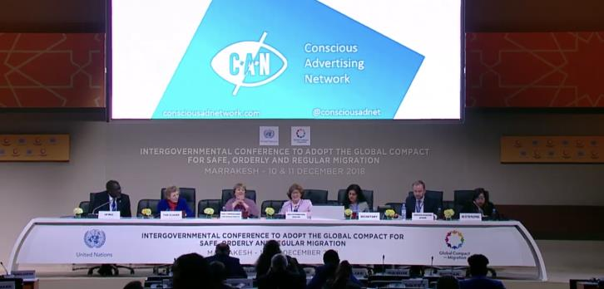
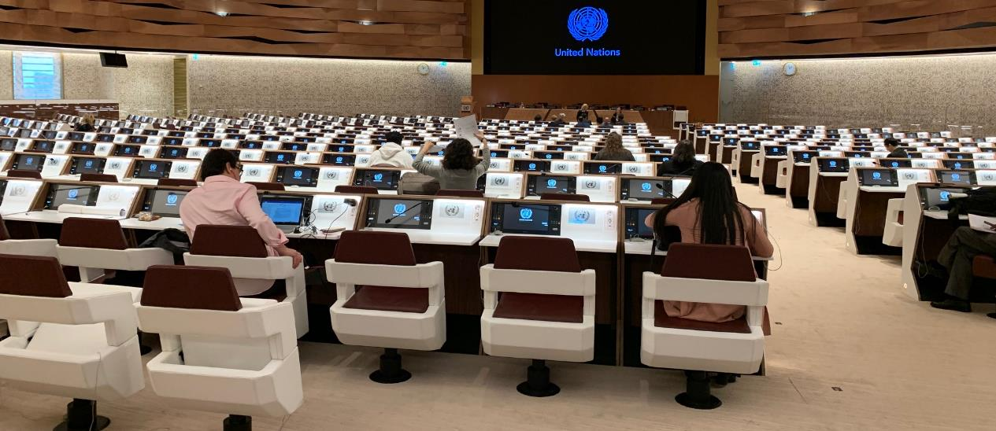
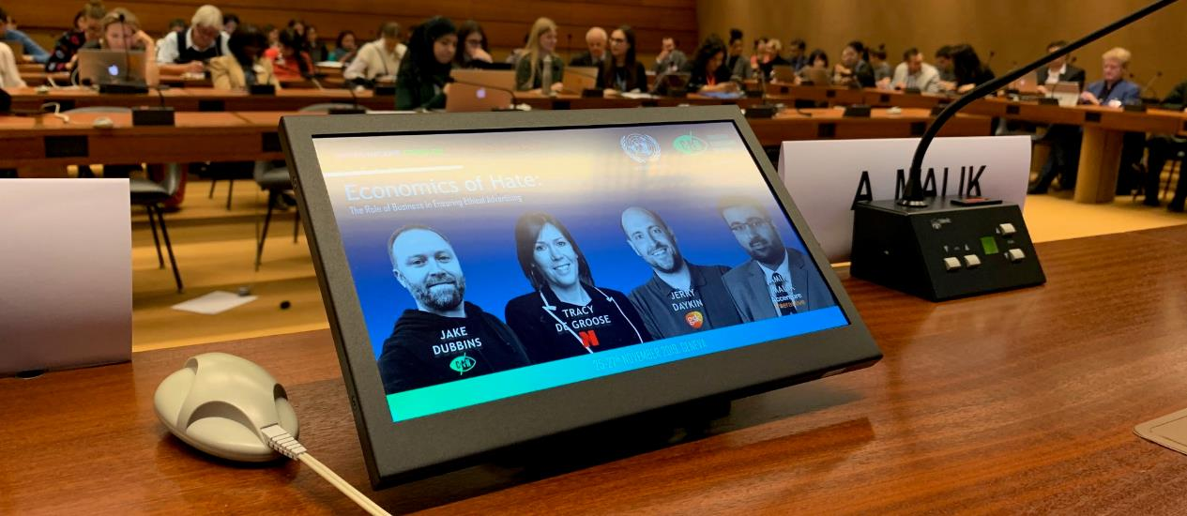
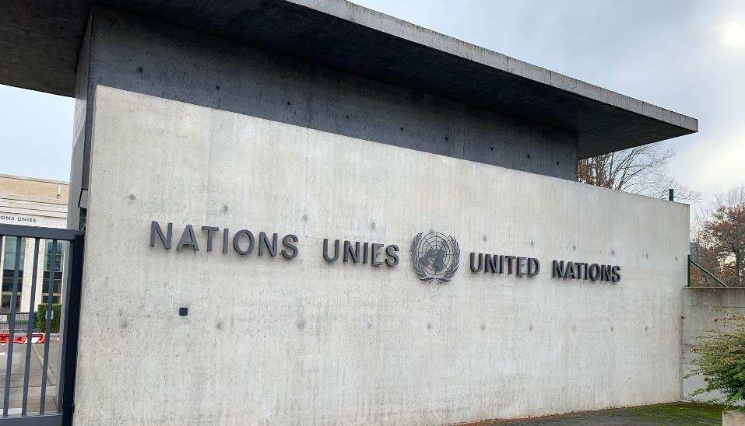
CAN Has Begun Partnering & Lobbying At All Levels – Including at the UN
Notes:
We work both to empower and support brands, and to take the conversation and action to higher levels. We’ve now twice presented at key United Nations events, as well as having a voice on global initiatives like the WFA’s Global Alliance for Responsible Media.

Slide 7

Flickr karmabomb1
To understand the challenge we now face
it’s helpful to consider the evolution
of media & marketing
Notes:
Flickr karmabomb1, Creative Commons license

Slide 8
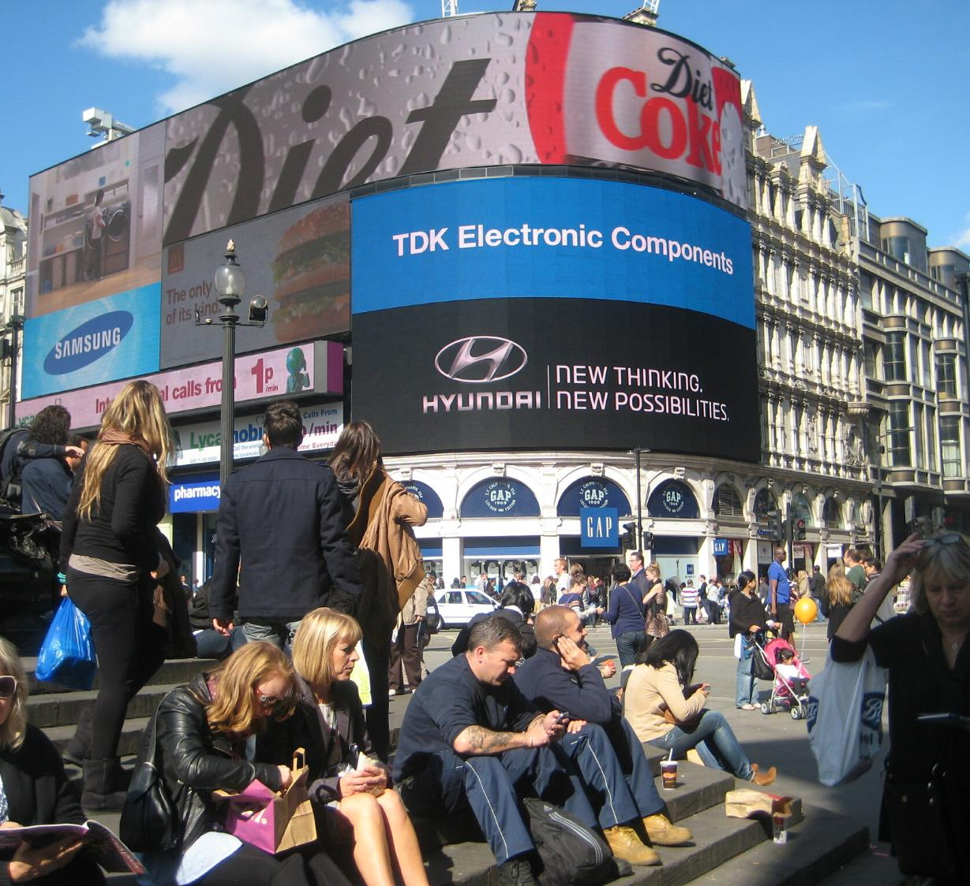
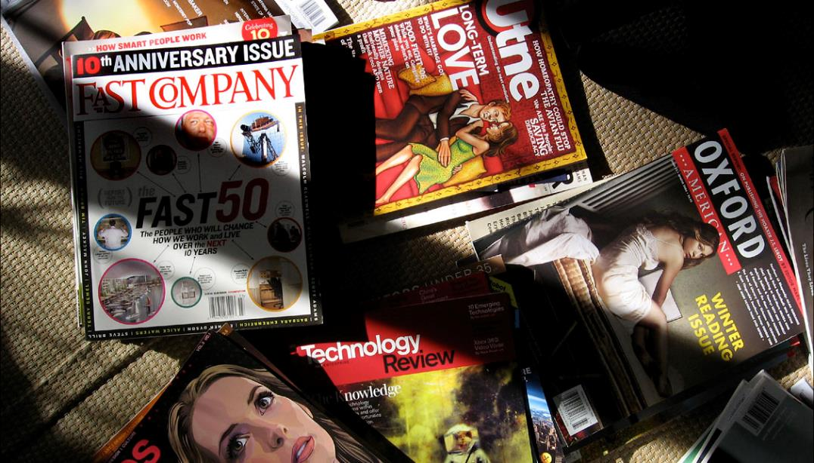
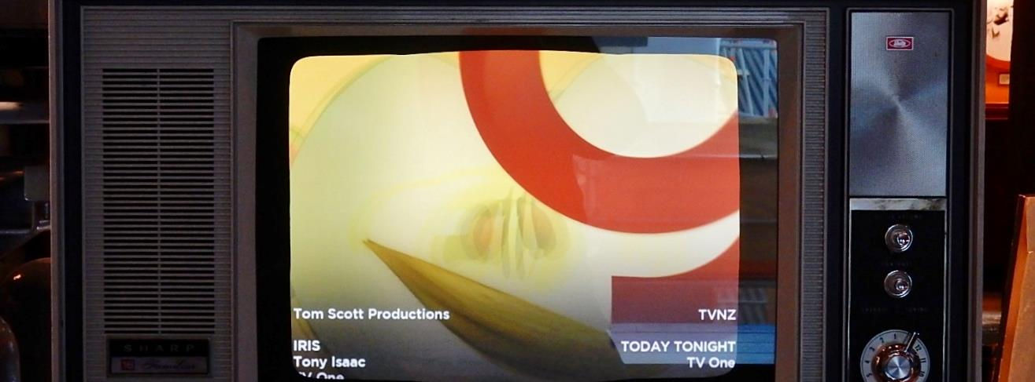
Flickr mikecogh, keithwj, aroberts
Traditional Marketing Channels
Notes:
Traditional media (like Out of Home, Print or Television) has always had a focus on context, and on placing adverts in trusted environments.
Flickr Creative Commons License, mikecogh, keithwj, aroberts

Slide 9
Advertising in a Traditional Media World
Positive Brand Safety Advantages
Mostly booked by direct human contact
Possibility of controlling exact context due to limited number of total placements
Confidence in the owners of the media and their regulatory standards
Advertising spend is funding reputable organisations, content & journalism
Negative Brand Safety Challenges
Still opportunities for ad misplacement
  Adult brands outside schools
  Travel brand in Plane Crash TV show
  Adjacent to terror related news article
Questionable biases, motivations and opinions still exist in the traditional media world and can reflect on associated brands
Notes:
In many cases, even to this day, this activity is booked by literally calling up (or emailing) a media owner and requesting specific placements
You can be confident in who is producing the content you appear alongside, as well as trust in the editorial standards which they will be held to by local regulators
There are certainly still opportunities for advert misplacement – adult brands can appear on out of home adverts outside a school, an airline might accidentally advertise during a TV show about an airplane crash, or you might sit alongside a newspaper article reporting on a terror incident which you might rather prefer.
BUT these cases are rare as typically some degree of human planning is involved, and also ultimately most consumers understand the distinction between the brands and the content around them, and realise they are not directly funding the bad actors in these cases.

Slide 10
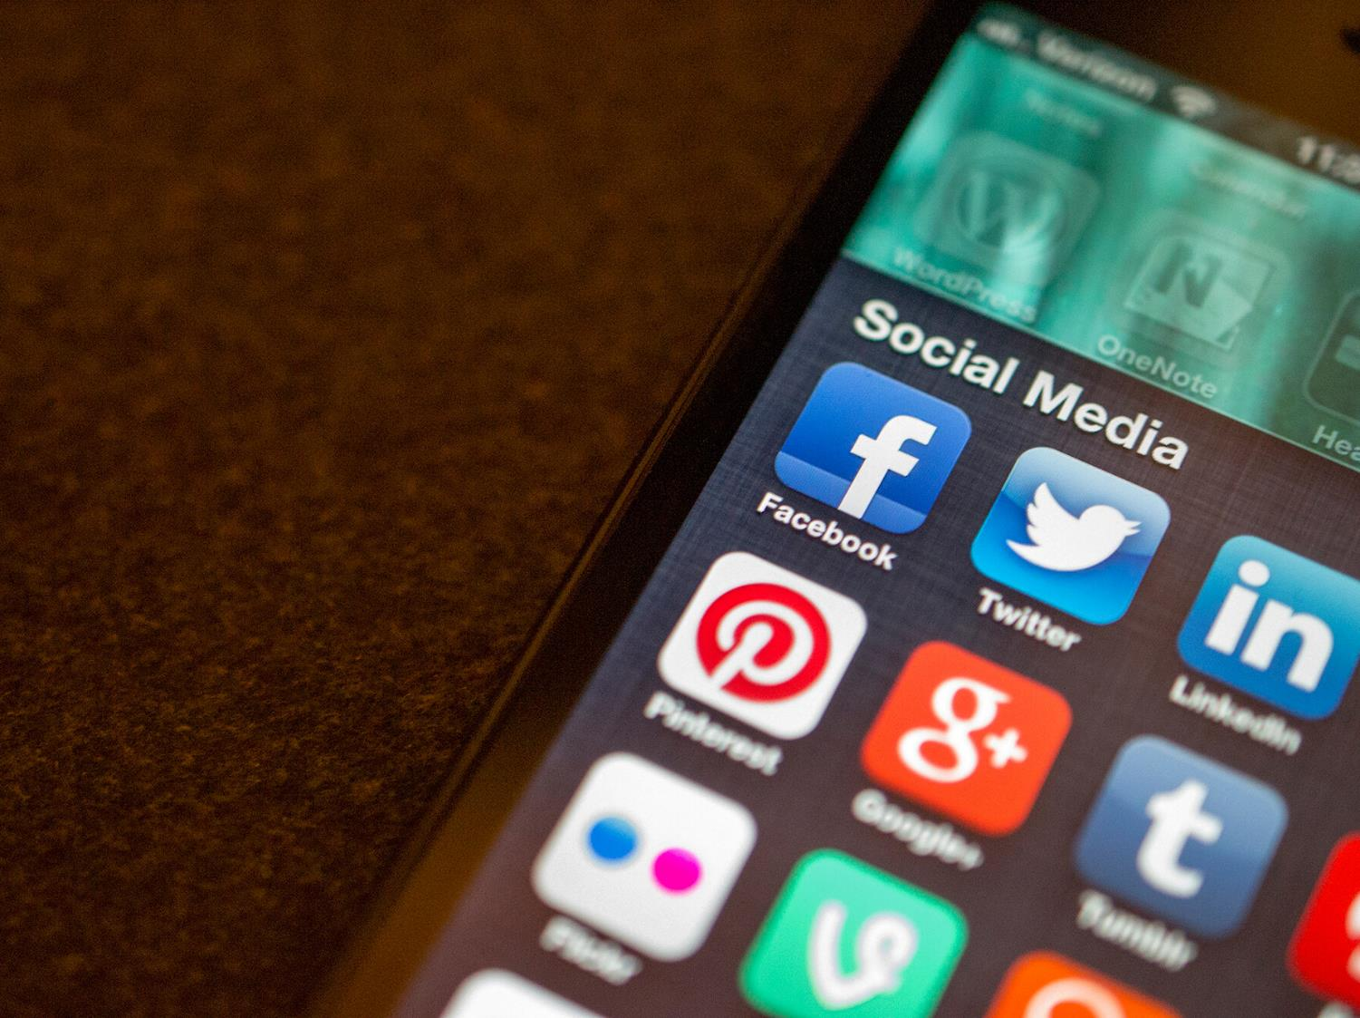
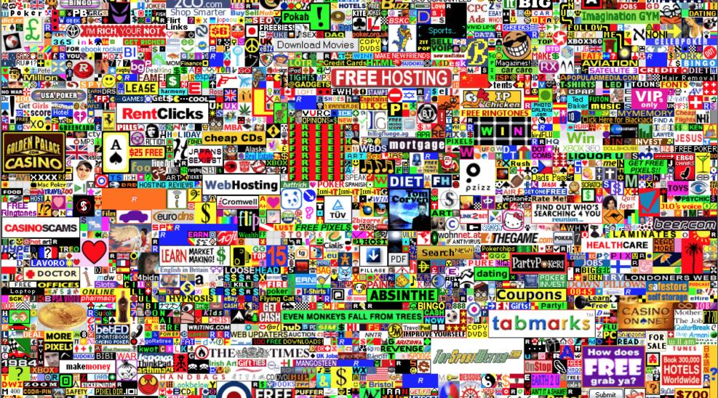
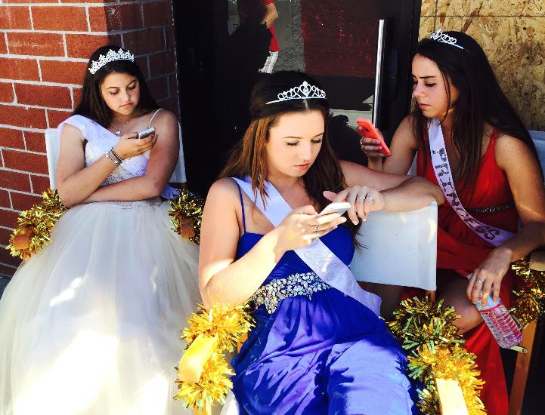
Flickr jasonahowie, telstar, Million Dollar Homepage
The Digital Media Revolution
Notes:
The digital revolution has introduced entirely new ways of advertising – display advertising, video advertising, social media advertising, mobile app advertising… countless different ways in which we can now reach consumers reflecting the different ways they are consuming media

Slide 11
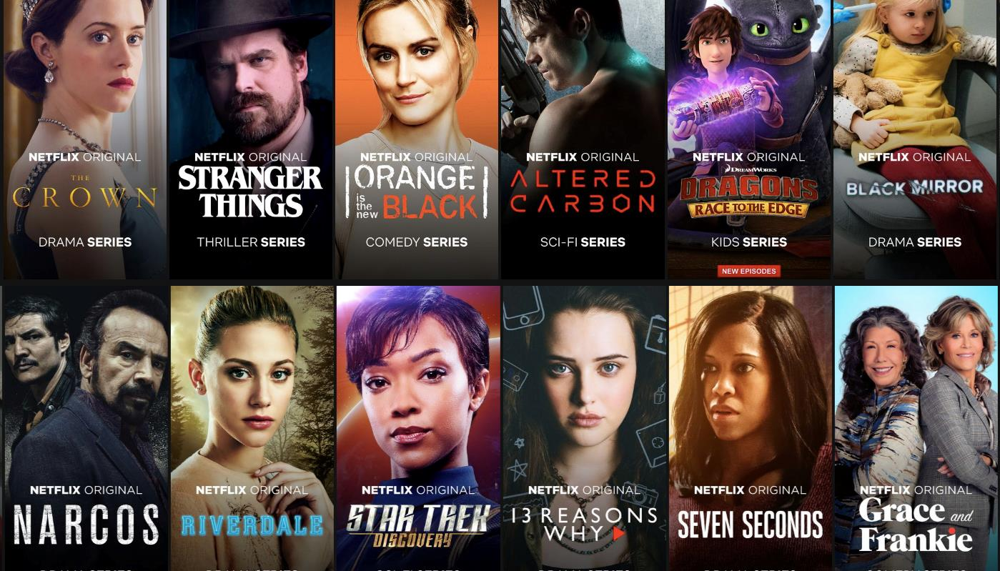

New Opportunities & Creativity
Notes:
And there are of course many fantastic advantages to such digital evolution…
New ways for consumers to connect and interact
A golden age of new content (eg Netflix originals)
New ways for marketers to reach consumers, target and engage them

Slide 12
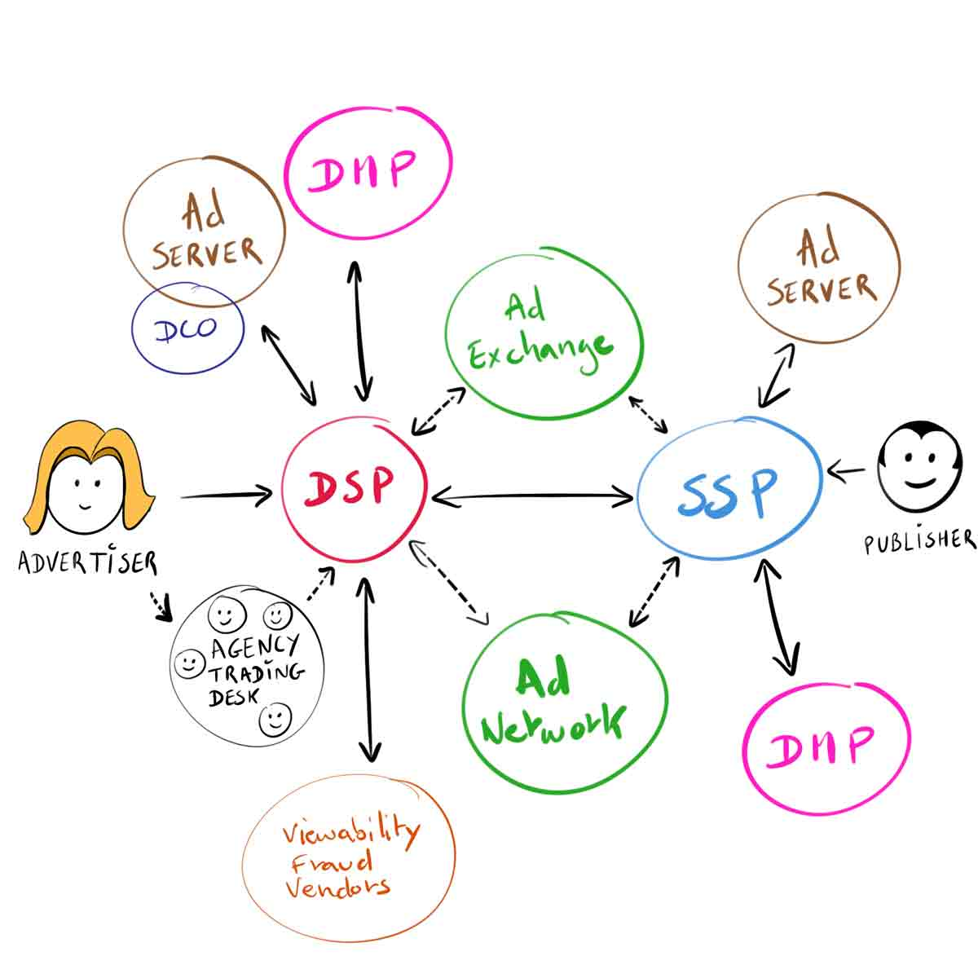
However simple you try and make the explanation, the journey from advertiser to publisher has become more complex.
Source DigitalThought.me
Notes:
But the digital revolution has CERTAINLY brought with it more than its fair share of complexity!
NB – no need to go into details attempting to explain how programmatic marketing works unless your audience really requires it, in most cases it is simply to visualise that there are a lot of factors at play.
DSP = Demand Side Platform (representing the advertiser’s demand)
SSP = Supply Side Platform (representing the publisher’s supply of media)
DMP = Data Management Platform (using data to inform targeting, and in turn acquiring new data from the activity run)
Source: https://digitalthought.me/articles/digital-marketing/Programmatic-ad-bidding-cookie-sync.html

Slide 13
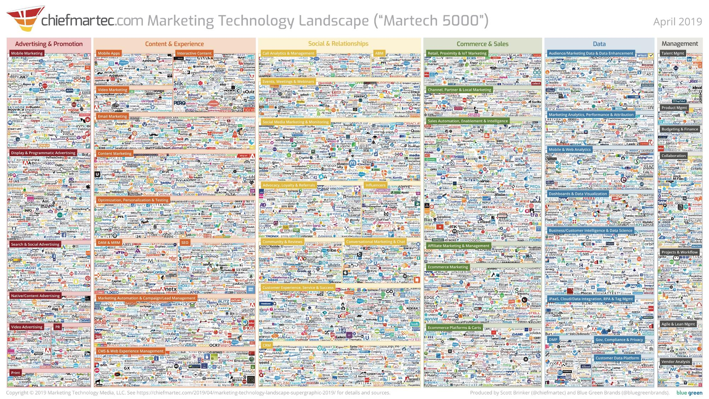
VASTLY More Complex
Notes:
‘Lunascape’ visualisation of the key ad tech/marketing technology landscape featuring 5,000 companies (and there are more out there)

Slide 14
Advertising in a New Digital Media World
Negative Brand Safety Challenges
Adverts typically placed ‘programmatically’ through automated computer algorithms
Campaigns can run across 10,000s of different placements to find their audience
Low barriers of entry & limited regulation mean websites run by unknown parties
Advertising spend can fund these unknown organisations, down to the individual level
Positive Brand Safety Opportunities
Verification technology can in theory avoid contextual ad mis-placement
Huge diversity of online content creates rich opportunities for brands to appear in positive contexts & support voices
Ad supported online model means brands remain critical to positive user experience
Notes:
Here are some of the key impacts this has had on our media buying approach. We’ll explore these in more detail.

Slide 15
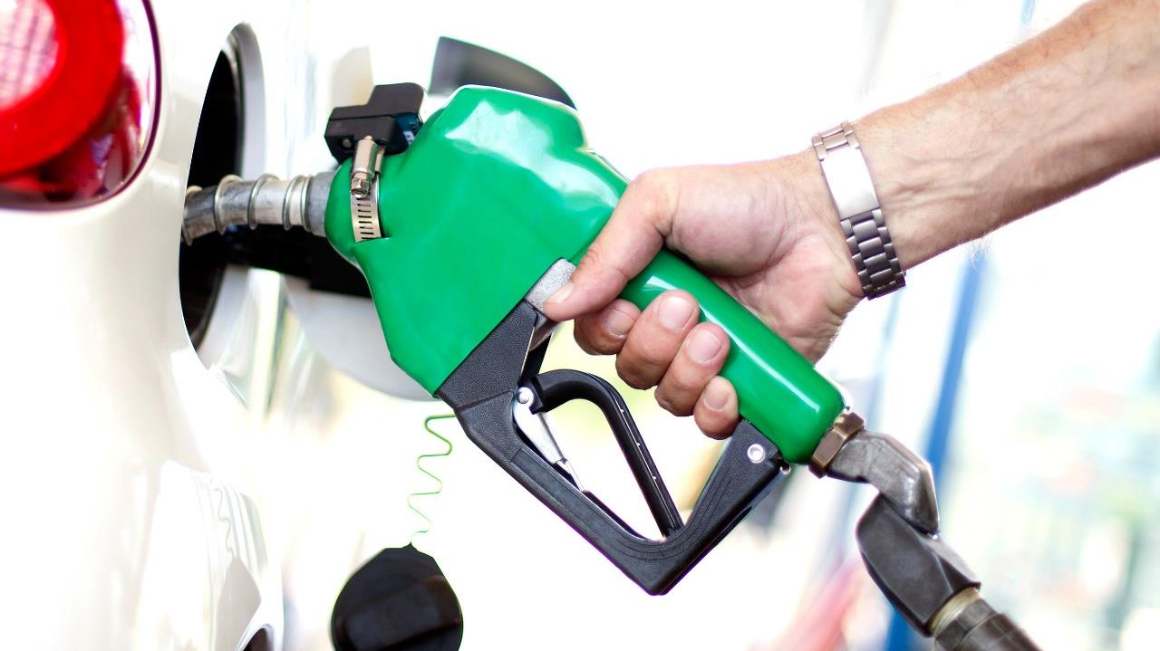
Marketing Fuels the Internet
Source BP
Notes:
There are of course subscription services and other exceptions… but the majority of internet content is funded by advertisers.
This has come so far that consumer expectation now is indeed that internet content SHOULD largely be free, and a great benefit of advertising is the funding of this content and the creation as a result of entertainment, news, social networks etc.

Slide 16
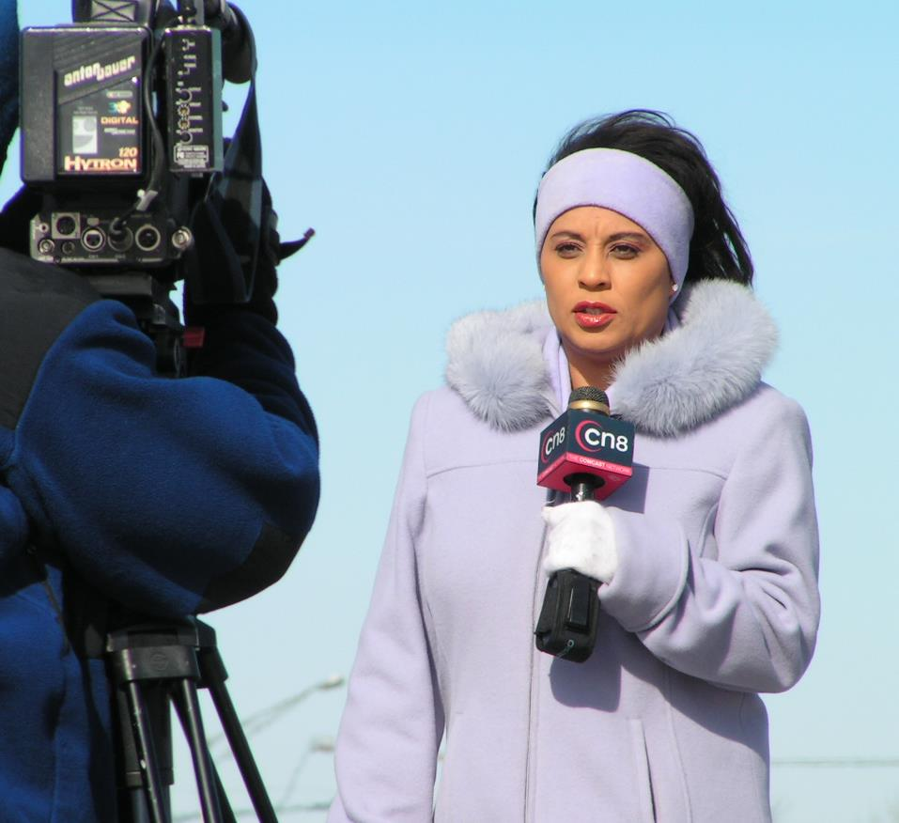

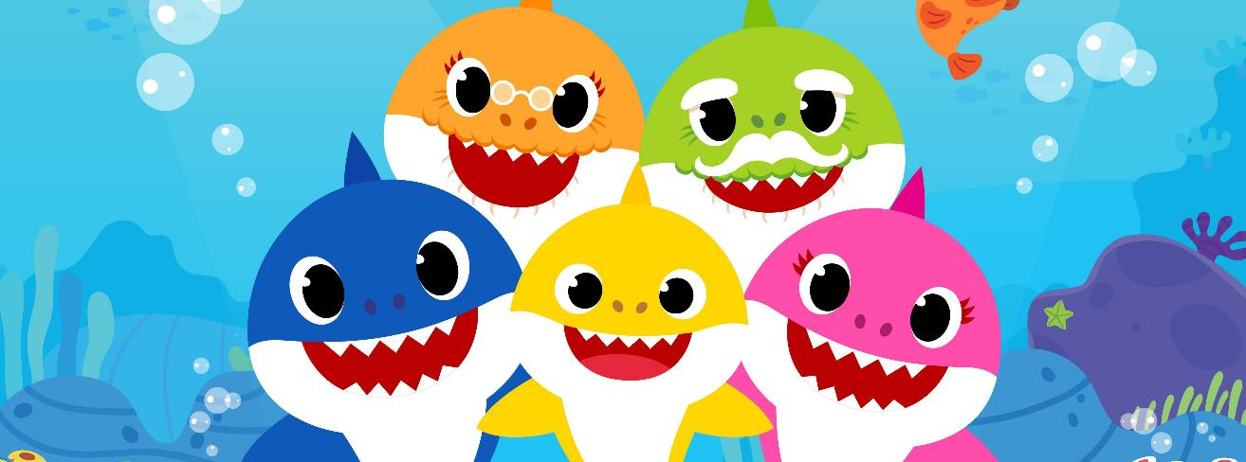
Advertising Funds Good Content
Notes:
There are many benefits of this – including the democratisation of content and access, giving individuals and minorities voices etc.
Critical journalism is largely funded by advertising revenues (though of course subscription models)
Social networks are free to their users thanks to ad support, these connect billions of people to friends, family, passions and interests. Social networks have fuelled democratic revolutions, and helped launch hundreds of thousands of small businesses and enterprises
Social networks allow individual influencers to fund the production of informative and entertainment content, or collectives like SortedFood to do the same
And we wouldn’t have BabyShark without internet advertising

Slide 17
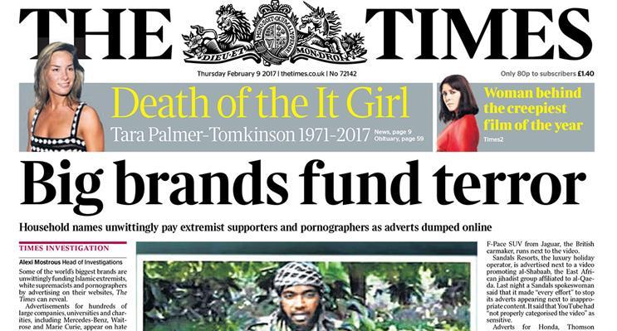


Advertising Funds Bad Content
Notes:
Celebrity plastic surgery slideshows designed to trick users into clicking on adverts are one outcome of advertisers overlooking context and ad placement as long as they achieve their views and digital metrics.
There are however far more serious implications than just bad user experience. As has become front page news brands have also found themselves adjacent to substantially worse experiences.
As with traditional news media there is a risk of appearing alongside articles on terrorist attacks or hate crimes, which most brands would rather steer far clear of… but uniquely to digital channels the issue goes even further. Advertising spends have actually been shown to support content directly encouraging hate speech, radicalisation and terrorist organisations.
In these instances advertisers aren’t just appearing next to unpleasant content, they are accidentally funding its creation and encouraging more of it to be made.

Slide 18

Advertising Budgets: Circa $600 Billion
CSR Budgets: Circa $50 Billion

Slide 19

But With Great Power,
Comes Great Responsibility
Source Sony Pictures
Notes:
If marketers are fuelling the internet we hold a high degree of responsibility for the content that shapes it, even if we do not have full editorial control.
Advertising has the opportunity to fund great positive experiences, but also the opportunity to fuel bad ones.
A lot of websites shape their experience specifically to capture more advertising dollars, and may sacrifice user experience in the process. This starts simply enough with websites squeezing in extra adverts around their content, but entire websites are now being built to force extra advert impressions by making users click through multiple page slide shows, or forcing them to watch adverts to continue.
Of course it also starts to shape the content too, creating a natural incentive for people to create controversial, click baity or even fake content if they know it will attract more attention.

Slide 20
Fake news, racism, sexism, terrorists spreading messages of hate, toxic content directed at children - parts of the internet we have is a million miles from where we thought it would take us
Keith Weed, President Advertising Association
12th February 2018

Slide 21
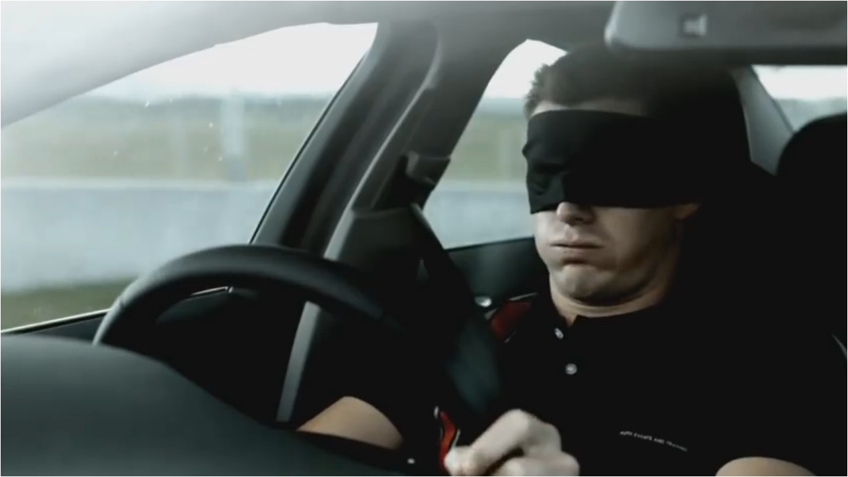
We’re Often Blind to What We’re Funding, or Defunding

Slide 22


Slide 23
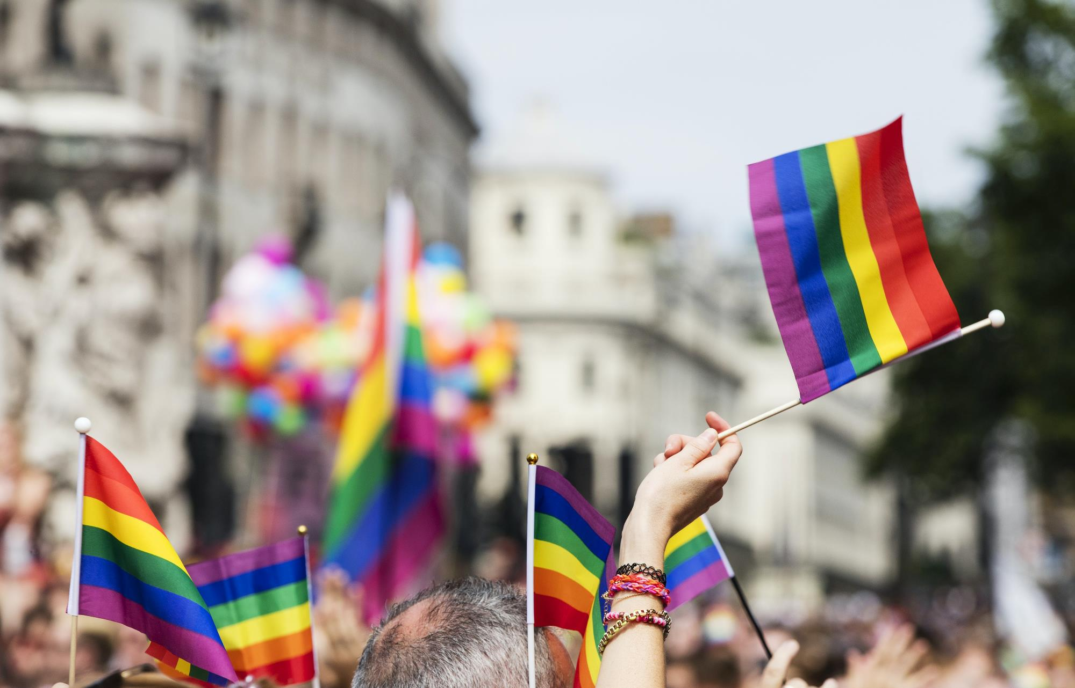

Slide 24


Slide 25
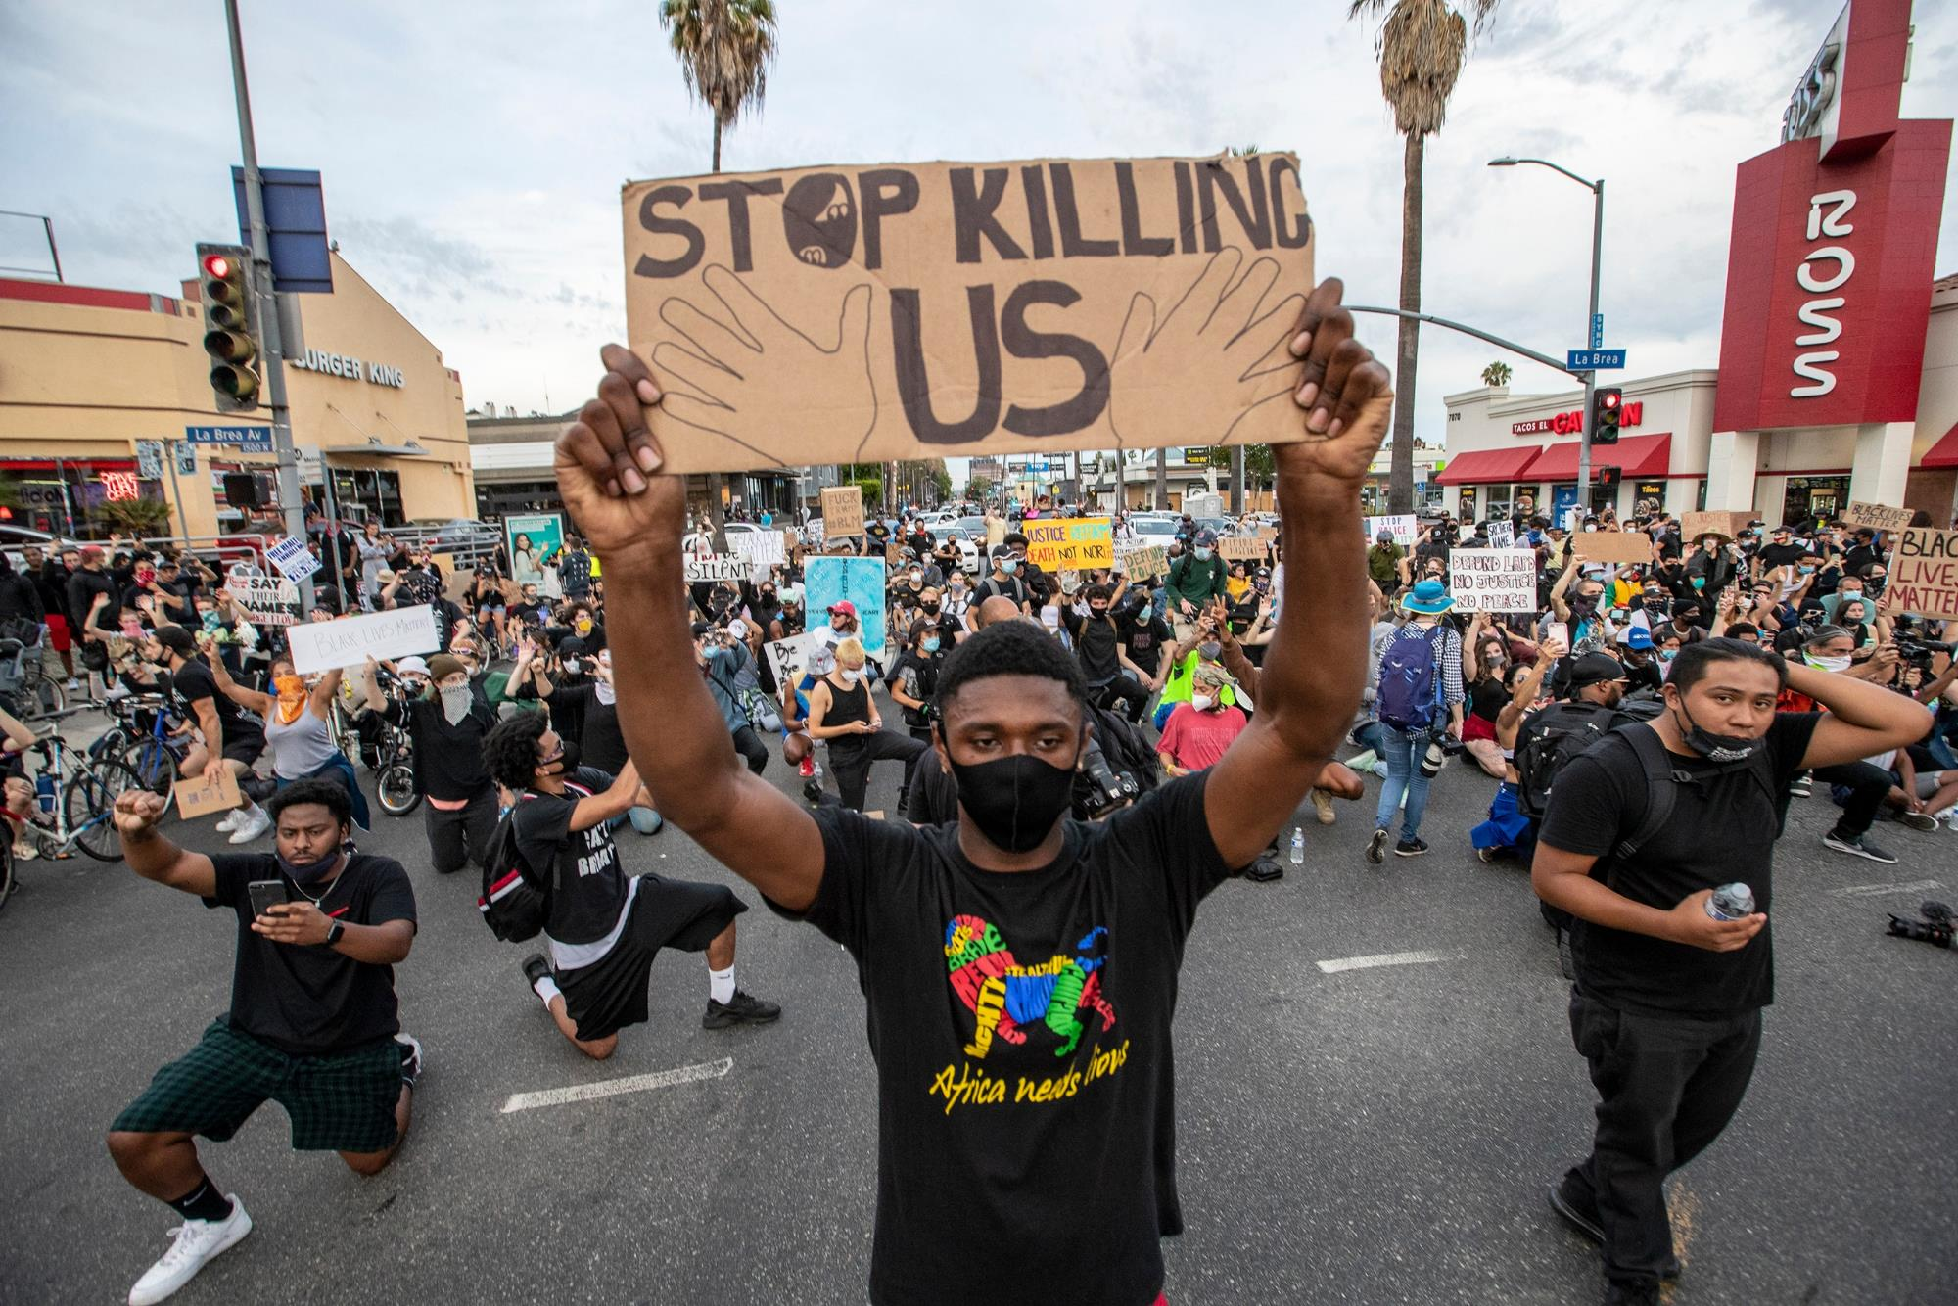

Slide 26
A Real Life Example: Tommy Robinson
‘Muslims are filthy scumbags’
Jan 2019
‘Make war on muslims’
Jan 2019
‘If you’re a journalist and you think your office or your home is a safe space …. It’s not’

Slide 27
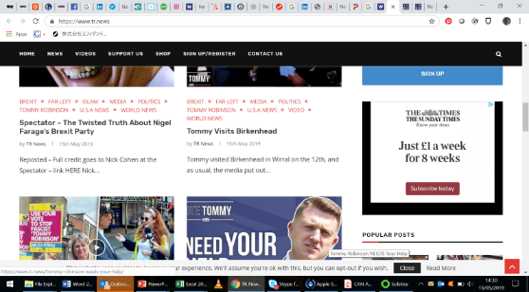
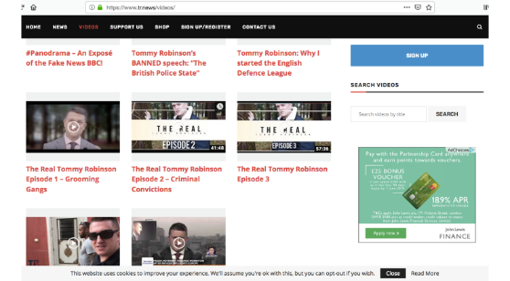
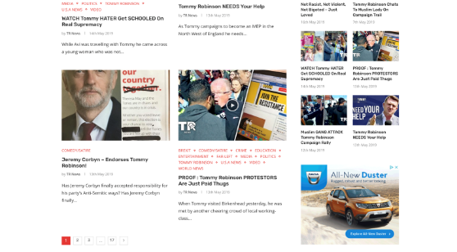
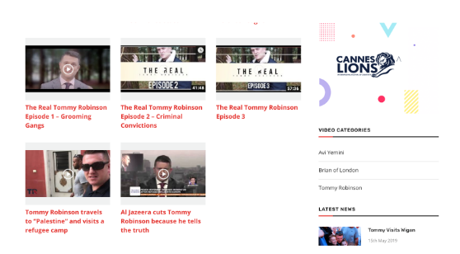
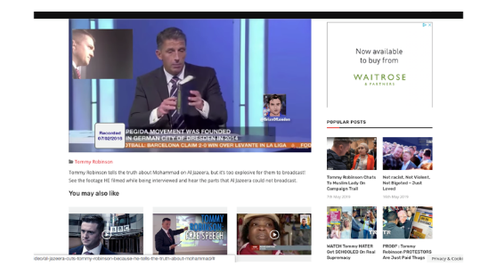
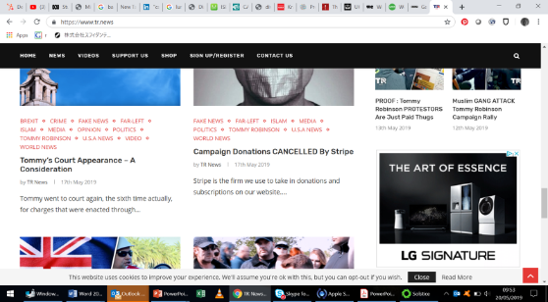
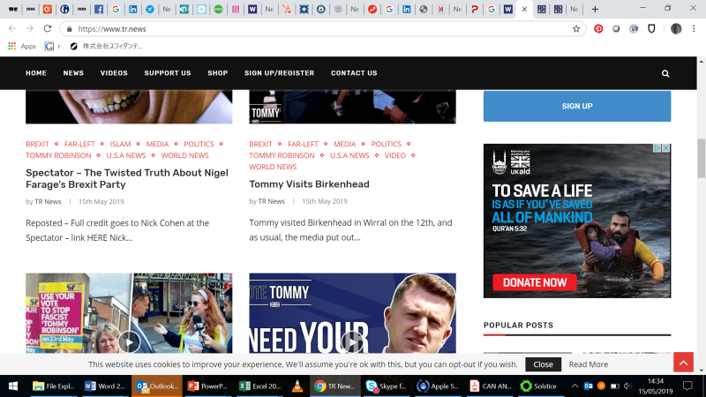
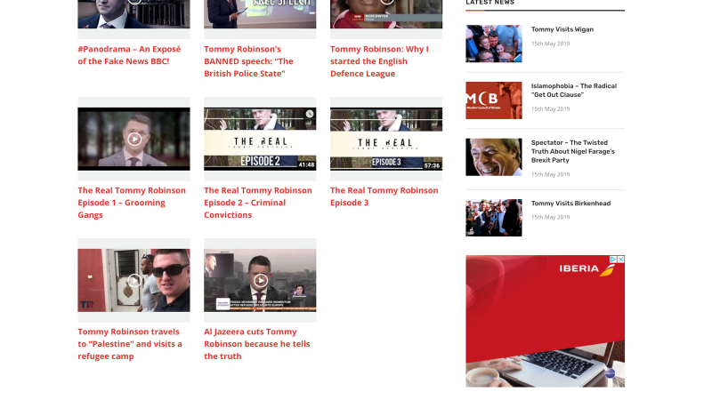
Dozens of Brands Were Accidentally Advertising on the TR.news Website

Slide 28






CAN Has 6 Focus Manifesto Areas
FAKE NEWS
HATE SPEECH
ANTI-FRAUD
DIVERSITY, INCLUSION AND EQUALITY
CHILDREN’S WELLBEING
INFORMED CONSENT
Notes:
WE SUPPORT THE FIGHT AGAINST FAKE NEWS
Advertisers must take the responsibility to ensure they don’t fund channels that fund fake
news, click-bait and any intentionally misleading content
WE SUPPORT ACTIONS THAT COUNTER HATE SPEECH
Advertising funds hate speech inadvertently. We must actively avoid media outlets that fuel
hatred on the grounds of race, religion, nationality, sexuality, gender, disability or any other
group characteristic
WE SUPPORT ANTI-FRAUD INITIATIVES
The whole digital advertising eco-system needs to take responsibility and be accountable for
minimizing ad-frauds across their relationships
WE SUPPORT DIVERISTY, INCLUSION AND EQUALITY
The content we create must be as diverse as the society we serve. To achieve this, we must
ensure that diverse teams make the diverse work that speaks to diverse audiences
WE SUPPORT THE WELLBEING OF CHILDREN
Advertising to children should be age appropriate, promote positive messaging and values
and avoid glamourizing negative behaviours
WE SUPPORT INFORMED CONSENT IN THE USE OF DATA FOR ADVERTISING
We believe in creating greater clarity, respect and transparency around how personal data is
used, what people receive in return and options for users to tailor their online experience

Slide 29

Not An Instant Fix, But A Journey Together
Brand Consciousness
Brand Suitability
Brand Quality
Brand ‘Safety’
Brand & Public At Risk
Notes:
There is no instant fix and guarantee that we wont be caught out, but what we can do is commit to trying to tackle the challenges as and when we face them.
One way to think about it is the notion of a ladder with the opportunity to climb ever higher over time.
Brands which truly take no action put themselves and the public at risk
Steps to introduce basic brand safety approaches are a key first step, though can be blunt and over simplistic
Brands can take further up that ladder by putting more focus on the quality of the inventory they buy, and really paying attention to the context and suitability, not just looking to avoid the worst of the internet but really to place themselves where they can be most relevant
At the top of the ladder is when brands become truly conscious about their media investments and really start seeing them as an investment in the internet they want to create. Of course marketing spends still need to deliver business results but they can do so whilst funding high quality content, journalism or even actively ensuring minority voices get heard.

Slide 30

Do The Next Right Thing

Slide 31
Flickr chanzephotoart
Responsible Media
Unpacking the challenges & opportunities
of modern advertising and marketing.
Jerry Daykin, Senior Media Director GSK Consumer Healthcare
(Conscious Advertising Network // Global Alliance Responsible Media)
Notes:
Flickr chanzephotoart, Creative Commons license

